Slide 1
False Position Method - Basics

Slide 2

The false-position method is a numerical method to solve equations of the form $f\left(x\right)=0$
The aim is to find an approximation $x_{r}$ of a root $r$ of the function $f$
Notes:
In this lecture we cover a second example of a bracketing method: the false position method
Historically this method is known as “Regula Falsi” which is Latin and means : the wrong rule.
In fact the false position method is very similar to the bisection method we learned previously.
It solves numerically equations of the form f(x)=0
And it aims to approximate the root r of the function y=f(x).
The difference compared to the bisection algorithm is the way a new interval [ai+1, bi+1] is generated out of an interval [ai, bi].
The bisection algorithm did simply cut into two equal segments the interval.
The false-position method will try to do this in a way leading, in some cases, to a faster algorithm.

Slide 3

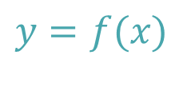













Bisection method
False-Position method
$$y$$
$$y$$
$$y=f(x)$$
$$y=f(x)$$
$$a_{i}$$
$$x_{c}$$
[
]
[
]
$$r$$
$$x$$
$$r$$
$$x$$
$$a_{i}$$
$$b_{i}$$
$$b_{i}$$
[
]
[
]
$$a_{i+1}$$
$$b_{i+1}$$
$$a_{i+1}$$
$$b_{i+1}$$
Notes:
Let us compare the two methods graphically.
The bisection algorithm cuts into two equal segments the interval [ai, bi].
It then decides in which halve the root r is located.
In the present example the root is in the right interval.
This interval becomes then the improved interval [ai+1, bi+1].
Let us now see how the false-position method proceeds.
As the bisection algorithm the methods aims to reduce the interval [ai, bi] into a smaller interval containing the root.
Instead of cutting [ai, bi] in two equal intervals, the false-position methods constructs an auxiliary line between the points (ai, f(ai) ) and (bi, f(bi)).
This line intercepts the x-axis in the point xc.
The method then decides if the root r is in the left interval [ai, xc] or the right interval [xc, bi].
In the present example it is in the right interval.
This interval becomes then the improved interval [ai+1, bi+1].

Slide 4






$$y$$
$$y=f(x)$$
$$a_{i}$$
$$x_{c}$$
[
]
$$r$$
$$x$$
$$b_{i}$$
Notes:
How do we calculate the cut point xc?
From the figure, using simple geometry it is straight forward to find the formula for the cut point xc.
To prove the formula simply look at the two highlighted triangles.
Using the fact that they are similar triangles the formula can easily be derived.
I encourage you to try to do it.
As a hint, start with the highlighted equation.
Be careful about the signs when you write your relations.

Slide 5
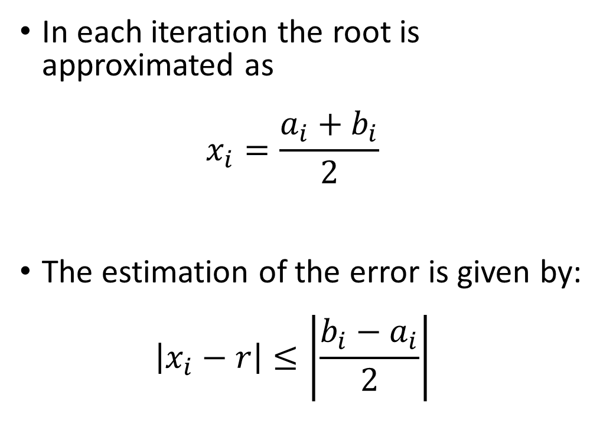
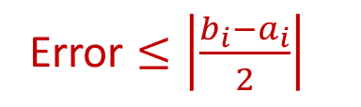



Approximation of the root and error control
In each iteration the root is approximated as $x_{i}=\frac{a_{i}+b_{i}}{2}$
The estimation of the error is given by: $\left|x_{i}−r\right|≤\left|\frac{{b_{i}−a}_{i}}{2}\right|$
Error $≤\left|\frac{b_{i}−a_{i}}{2}\right|$
$$a_{i}$$
$$x_{i}$$
$$r$$
$$b_{i}$$
Notes:
Now we know how the false-position algorithm reduces the interval in each iteration.
As all bracketing methods the algorithm provides a series of intervals [ai, bi] bracketing the roots.
The calculation of the approximation xi of the root r and the estimation of the error is done the same way as in the bisection algorithm.
The approximation xi of the root is given by the midpoint of the interval
The estimation of the error is half of the length of the interval.

Slide 6
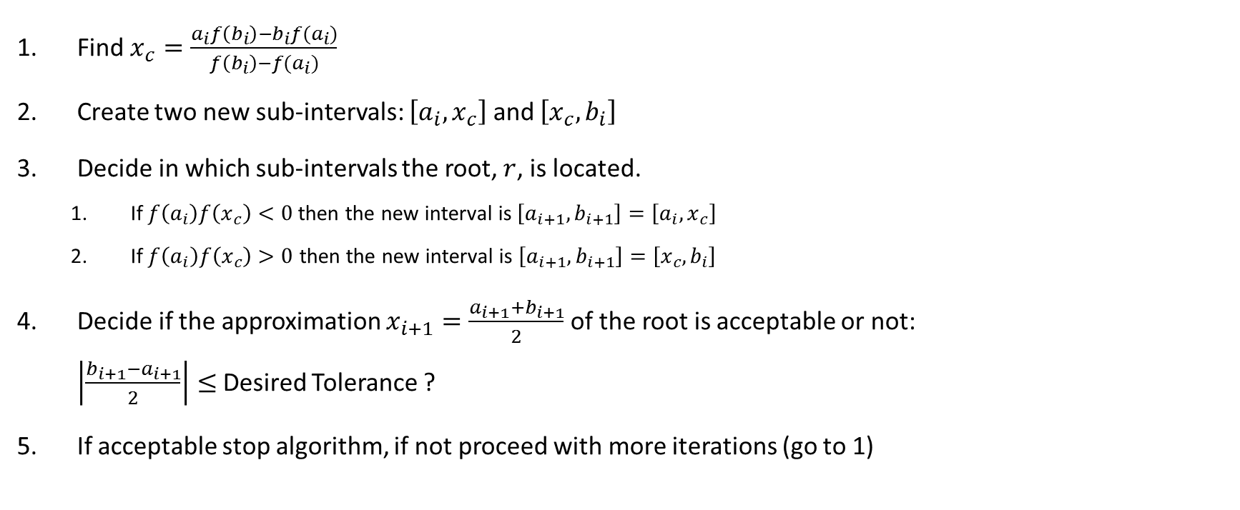
False Position Algorithm with Error Control
Find $x_{c}=\frac{a_{i}f\left(b_{i}\right)−b_{i}f(a_{i})}{f\left(b_{i}\right)−f(a_{i})}$
Create two new sub-intervals: $\left[a_{i},x_{c}\right]$ and $\left[x_{c},b_{i}\right]$
Decide in which sub-intervals the root, $r$, is located.
If$f\left(a_{i}\right)f\left(x_{c}\right)<0$ then the new interval is$\left[a_{i+1},b_{i+1}\right]=\left[a_{i},x_{c}\right]$
If $f\left(a_{i}\right)f\left(x_{c}\right)>0$ then the new interval is $\left[a_{i+1},b_{i+1}\right]=\left[x_{c},b_{i}\right]$
Decide if the approximation $x_{i+1}=\frac{a_{i+1}+b_{i+1}}{2}$ of the root is acceptable or not: $\left|\frac{b_{i+1}−a_{i+1}}{2}\right|≤$ Desired Tolerance ?
If acceptable stop algorithm, if not proceed with more iterations (go to 1)
Notes:
We have now all ingredients to write down the algorithm including error control.
Let us summarize the steps of the false-position algorithm.
They are essentially the same as for the bisection algorithm.
It is an excellent exercise to compare these steps with the ones from the bisection method.
In each iteration start by computing the cut-point xc of the interval [ai, bi]
Form the two sub-intervals
Decide in which interval is located based on the sign of f(ai)f(xc)
Now proceed with the quality control. Decide if the approximation is close enough to the root r based on the tolerance you would like to reach.
If the approximation is good enough you can stop the iterations. If not, you need to do more iterations.
In each iteration you can as well give the approximation xi of the root as being ai+bi divided by two.

Slide 7
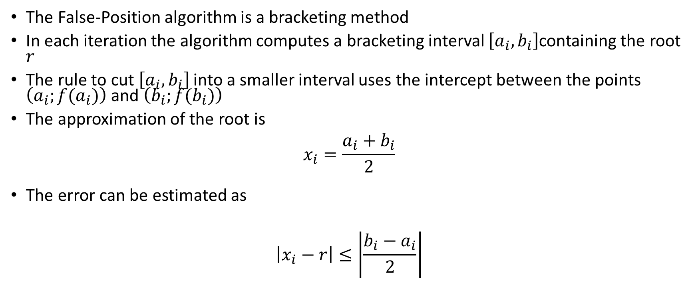
Summary
The False-Position algorithm is a bracketing method
In each iteration the algorithm computes a bracketing interval $\left[a_{i},b_{i}\right]$containing the root $r$
The rule to cut $\left[a_{i},b_{i}\right]$ into a smaller interval uses the intercept between the points $\left(a_{i};f(a_{i})\right)$ and $\left(b_{i};f(b_{i})\right)$
The approximation of the root is
$$x_{i}=\frac{a_{i}+b_{i}}{2}$$
The error can be estimated as
$$\left|x_{i}−r\right|≤\left|\frac{b_{i}−a_{i}}{2}\right|$$
Notes:
Let us summarize the key findings
The False-Position algorithm is a bracketing method
In each iteration the algorithm computes a bracketing interval $\left[a_{i},b_{i}\right]$containing the root $r$
The rule to cut $\left[a_{i},b_{i}\right]$ into a smaller interval uses the intercept between the points $\left(a_{i};f(a_{i})\right)$ and $\left(b_{i};f(b_{i})\right)$
The approximation of the root is $x_{i}=\frac{a_{i}+b_{i}}{2}$
The error can be estimated as $\left|x_{i}−r\right|≤\left|\frac{b_{i}−a_{i}}{2}\right|$

